Slide 1

Embedded Software Design
Ambuj Varshney
ambujv@nus.edu.sg
Notes:
++ Thank you for inviting me to give this talk
++ In this talk, I will present a pathway that can enable us to make wireless embedded systems ubiquitous. I will describe my previous research efforts that tackle the critical challenges that limit the growth of wireless embedded systems. These are related to the growing energy asymmetry that exists between sensing, computation and communication blocks on these platforms.
++ Finally, I will conclude my talk by covering the research agenda that I would like to work on as a faculty member.

Slide 2
Course Information
Notes:
++ Over the past few years, I have designed several backscatter and beyond backscatter systems that precisely overcome these critical challenges that have limited the widespread deployment of backscatter on IoT devices.
++ The research vision that I have pursued and would like to pursue as a faculty member is to enable a massive deployment of IoT devices by bridging the energy asymmetry between sensing, computation and communication blocks by designing novel platforms and communication mechanisms. I am going to describe some of my research contributions next.

Slide 3
Administrative Stuff
Deadline for project problem, seminar paper selection: 10th March 2024
Equipment for Project: End of recess week (Before 4th March 2024)
List of papers for seminar and student selection
Project can be done in a group of two. We would need statement of work
Term paper, Student Seminar are INDIVIDUAL tasks
Notes:
Backscatter communication actually help us overcome this limitation

Slide 4
Important Deadlines
Event | Date
Lectures | Starting Week 1 (15th January)
Student seminar paper selection | 10th of March 2024
Finalising project statement | 10th of March 2024
Student seminars | Lectures from 18th March
Project presentation | 15th April 2024
Term paper submission | 19th April 2024
Project submission | 19th April 2024

Slide 5
Let us recall what we covered in the last lecture
Notes:
++ Over the past few years, I have designed several backscatter and beyond backscatter systems that precisely overcome these critical challenges that have limited the widespread deployment of backscatter on IoT devices.
++ The research vision that I have pursued and would like to pursue as a faculty member is to enable a massive deployment of IoT devices by bridging the energy asymmetry between sensing, computation and communication blocks by designing novel platforms and communication mechanisms. I am going to describe some of my research contributions next.

Slide 6
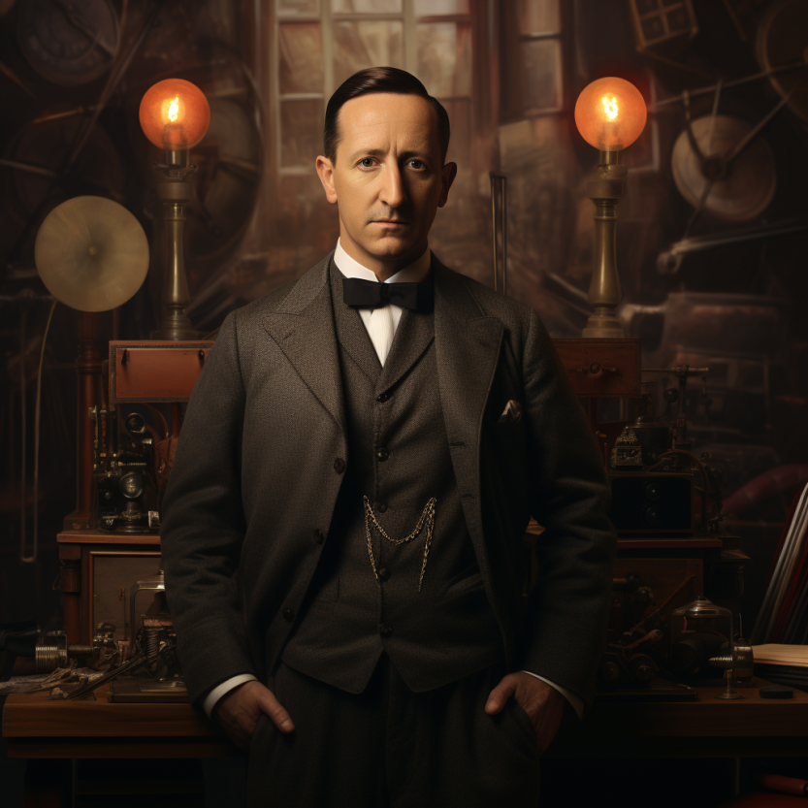
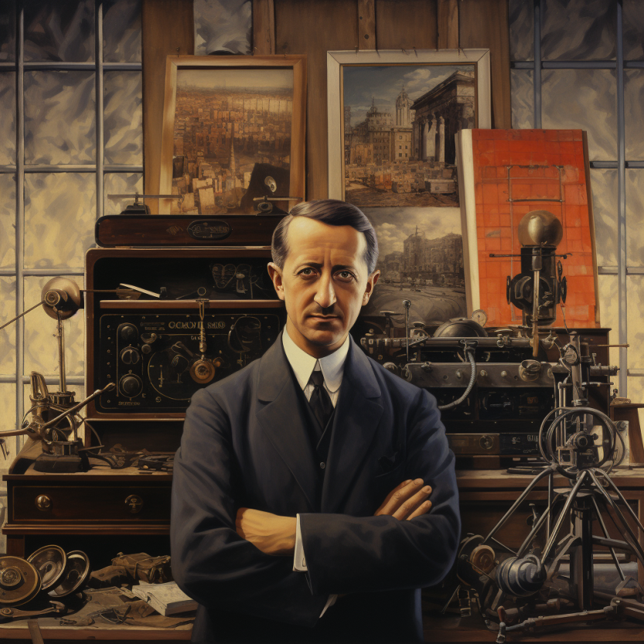
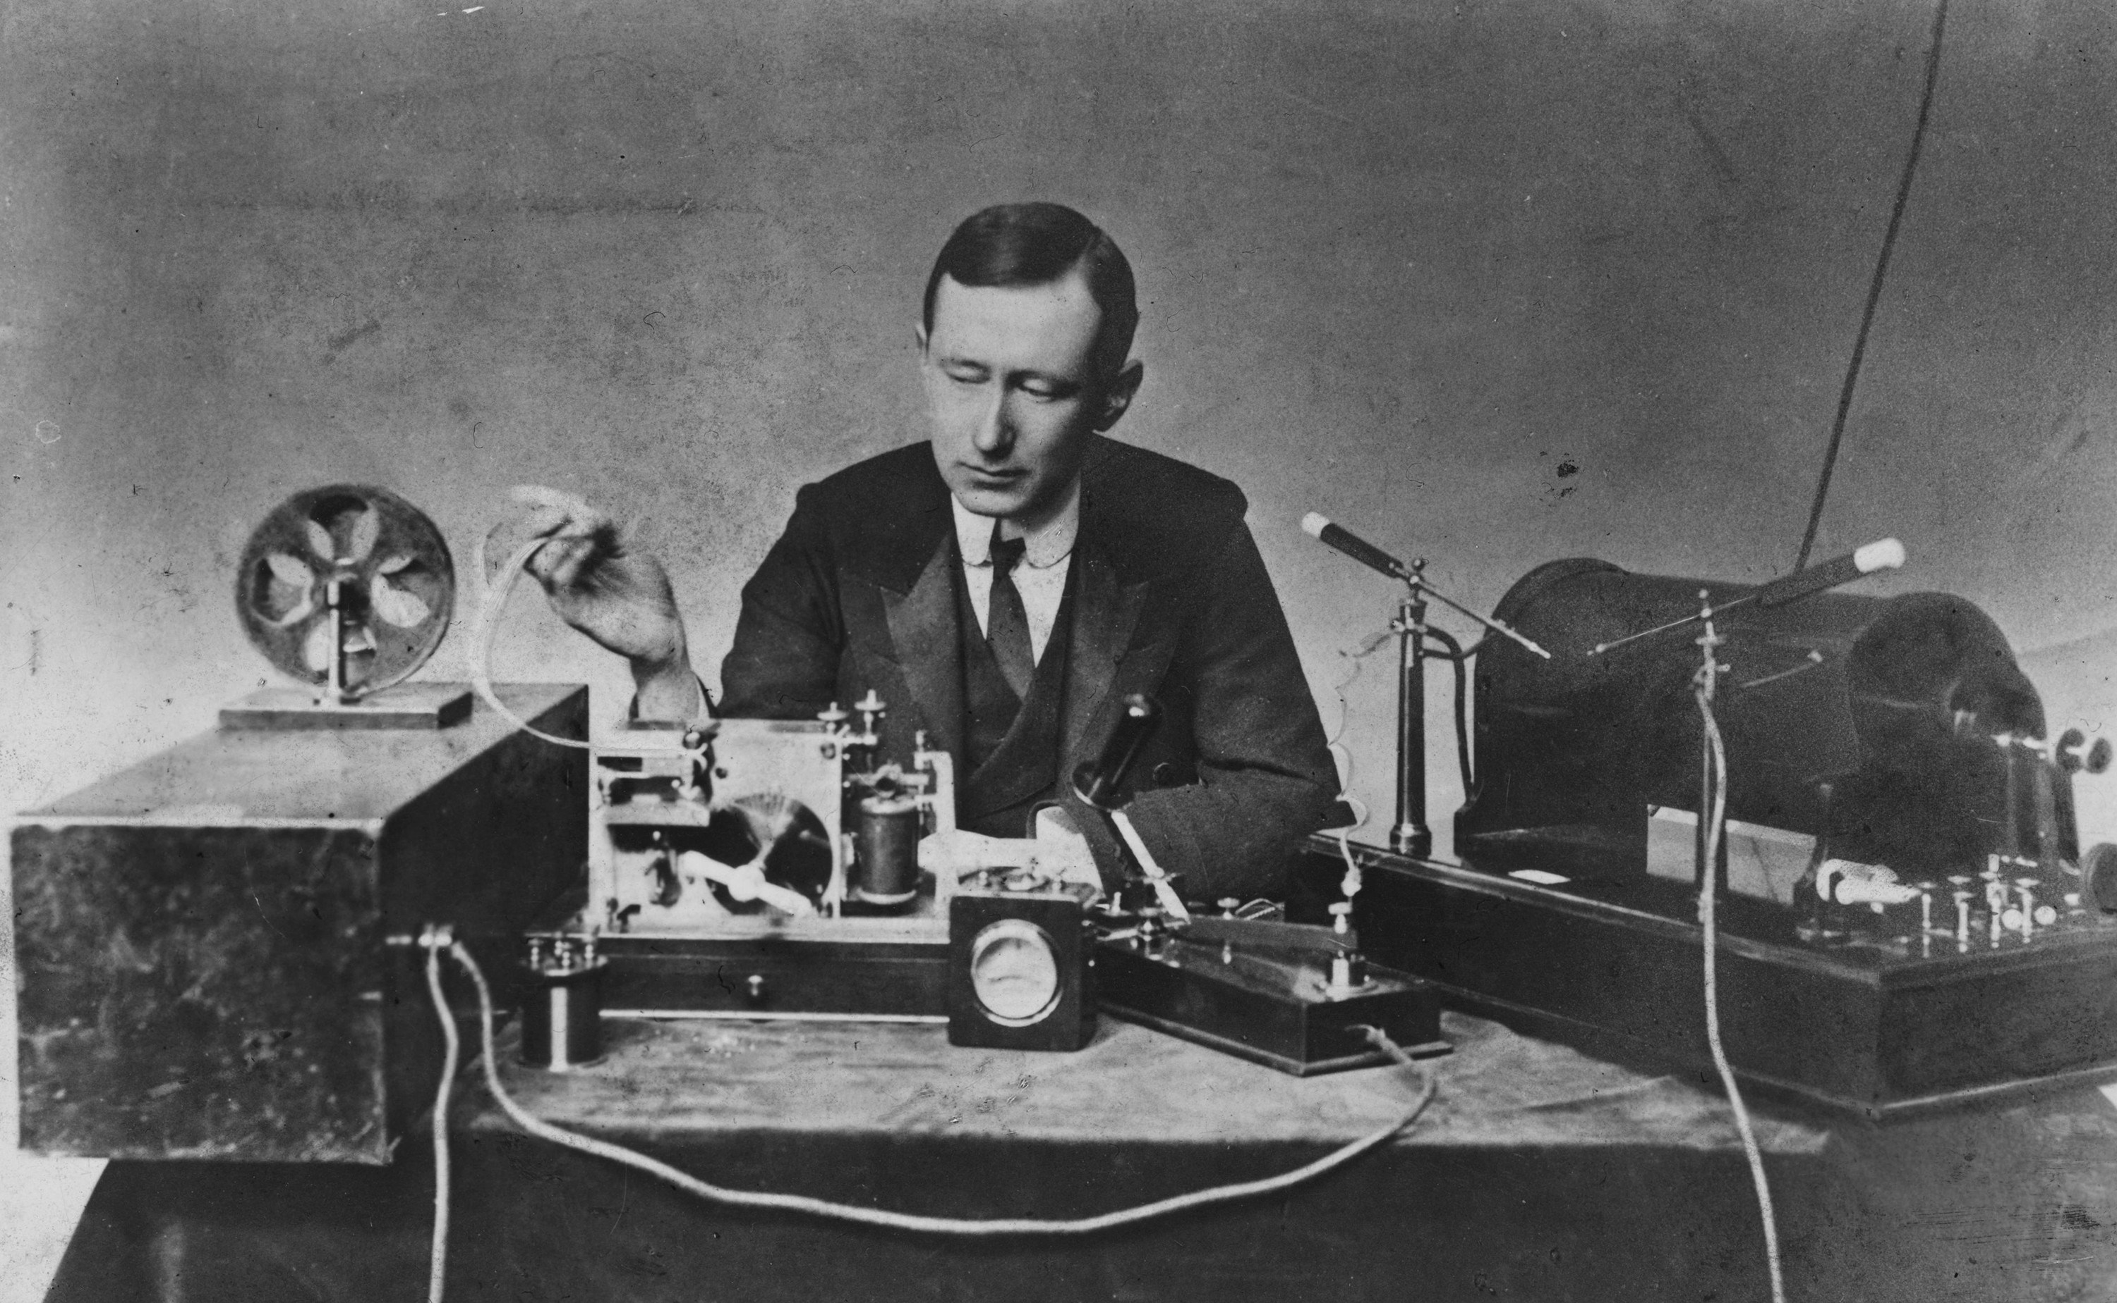
History of Wireless Transmissions
First to demonstrate wireless communication ?
1896: Guglielmo Marconi's first radio transmissions, coded signals that were transmitted only about 1.6 km (a mile)
1899: Marconi sends a signal over the English Channel ~50km
Notes:
First, we look at the computational elements, and these consist of a microcontroller or an FPGA. Today, we find that these computational elements consume at least one order of magnitude higher power consumption when compared to the commonly used sensors.
However, we also find that microcontrollers are increasingly becoming energy efficient. We investigate a typical microcontroller that has been used in sensor platforms over the past two decades. We find that energy efficiency has improved by almost two orders of magnitude. Some of the present-generation microcontrollers, such as Ambiq Apollo4 consume just 3 uA/MHz than 330 uA for MSP430 used on platforms such as TelOS B.
If the trend continues, we can expect the microcontrollers to catch up with the sensors and become energy-efficient. This significant improvement is that the digital components are increasing becoming efficient as they follow moore’s law.

Slide 7

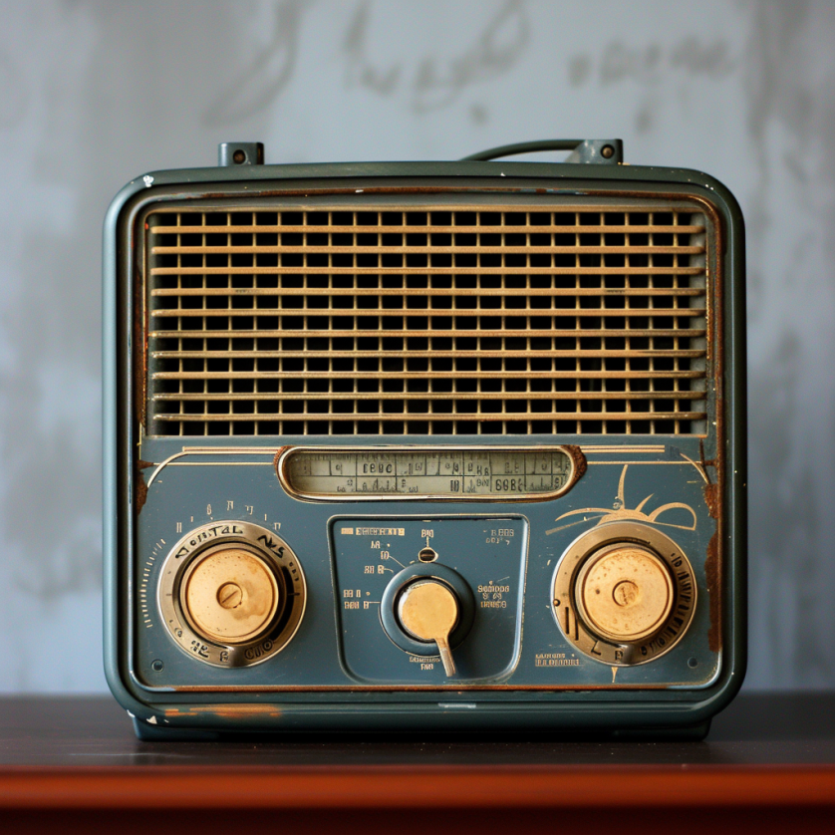
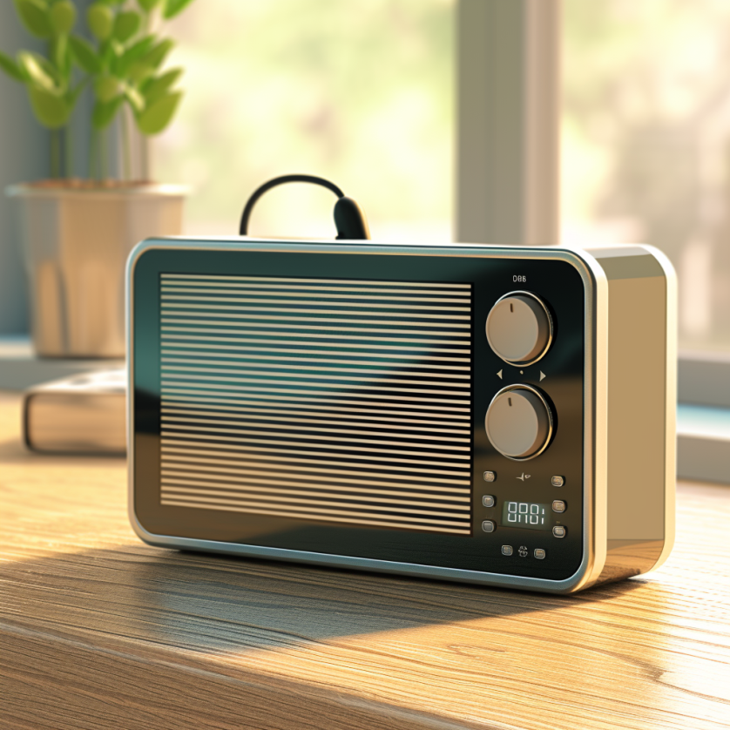
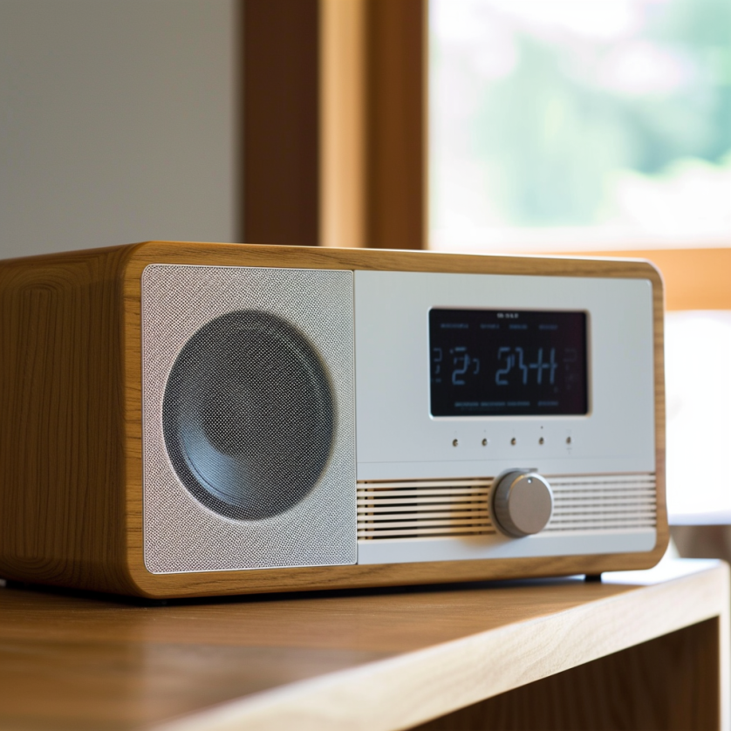
What does the term radio means?
Notes:
First, we look at the computational elements, and these consist of a microcontroller or an FPGA. Today, we find that these computational elements consume at least one order of magnitude higher power consumption when compared to the commonly used sensors.
However, we also find that microcontrollers are increasingly becoming energy efficient. We investigate a typical microcontroller that has been used in sensor platforms over the past two decades. We find that energy efficiency has improved by almost two orders of magnitude. Some of the present-generation microcontrollers, such as Ambiq Apollo4 consume just 3 uA/MHz than 330 uA for MSP430 used on platforms such as TelOS B.
If the trend continues, we can expect the microcontrollers to catch up with the sensors and become energy-efficient. This significant improvement is that the digital components are increasing becoming efficient as they follow moore’s law.

Slide 8
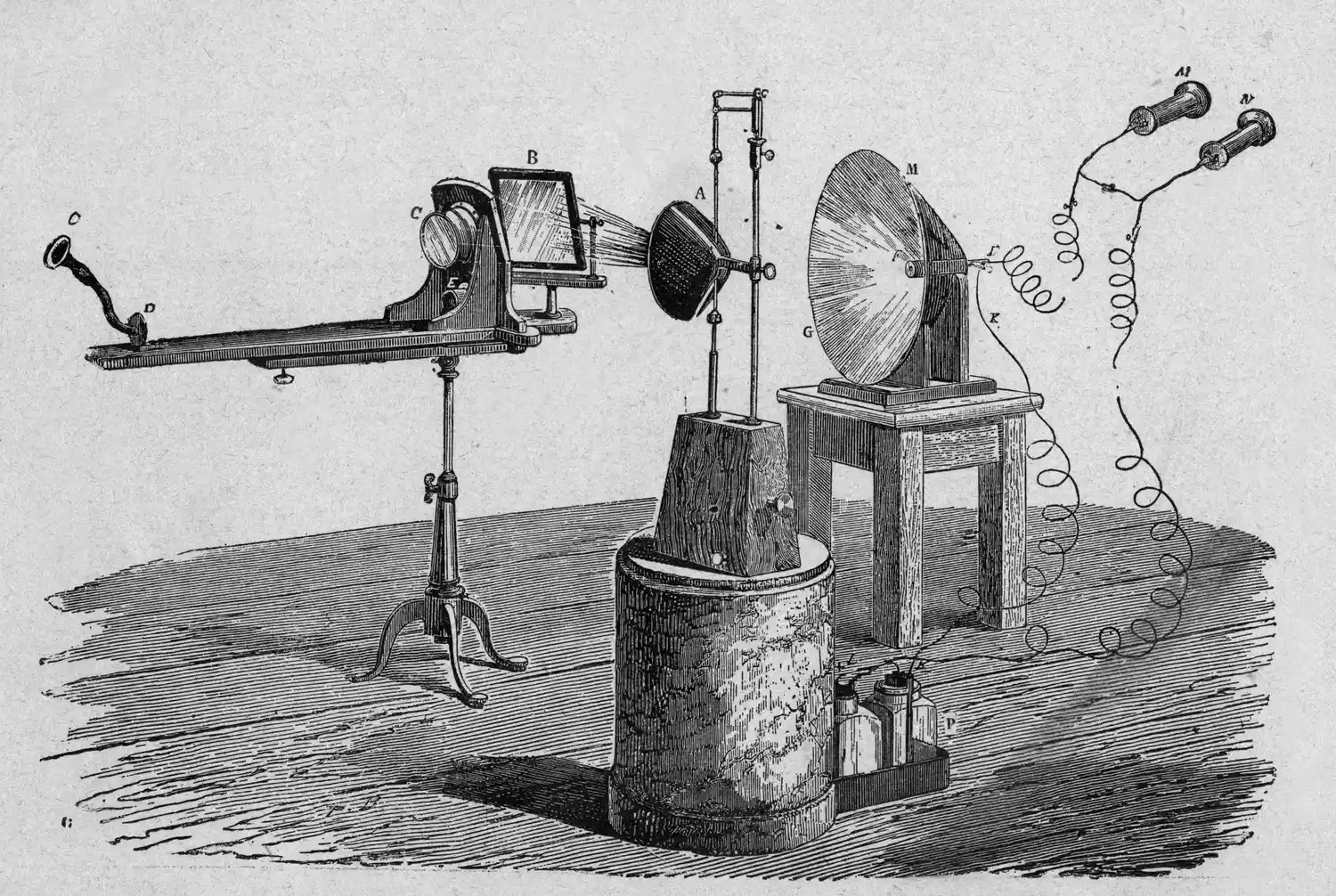
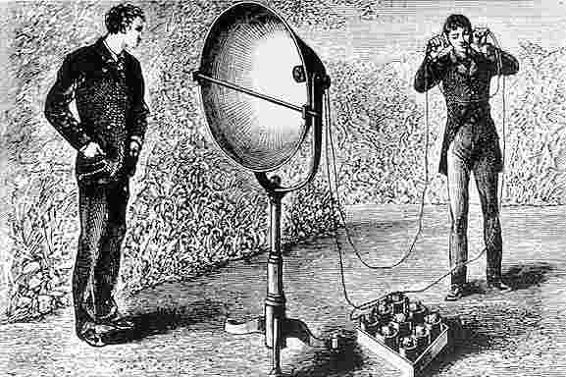
What does the term radio means?
The term radio originates from the Latin "radius," signifying "spoke of a wheel" or "ray of light." It was first used in communication context in 1881. French scientist Ernest Mercadier suggested the term, leading Alexander Graham Bell to name his photophone system "radiophone," which translates to "radiated sound."
Notes:
First, we look at the computational elements, and these consist of a microcontroller or an FPGA. Today, we find that these computational elements consume at least one order of magnitude higher power consumption when compared to the commonly used sensors.
However, we also find that microcontrollers are increasingly becoming energy efficient. We investigate a typical microcontroller that has been used in sensor platforms over the past two decades. We find that energy efficiency has improved by almost two orders of magnitude. Some of the present-generation microcontrollers, such as Ambiq Apollo4 consume just 3 uA/MHz than 330 uA for MSP430 used on platforms such as TelOS B.
If the trend continues, we can expect the microcontrollers to catch up with the sensors and become energy-efficient. This significant improvement is that the digital components are increasing becoming efficient as they follow moore’s law.

Slide 9
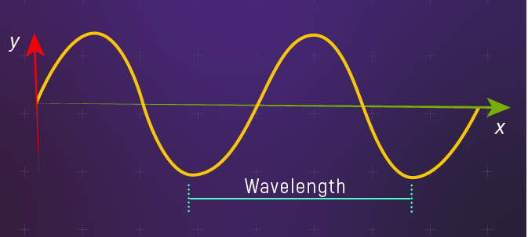
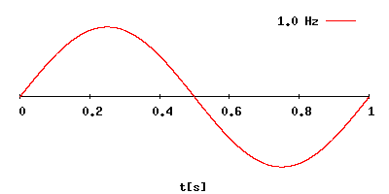
Fundamentals of electromagnetic waves
Electromagnetic (EM) waves are synchronized oscillations of electric and magnetic field. There is a periodic change of electric and magnetic field
How often this periodic change occurs dictates the property of EM waves
Changer period is termed as the frequency. The SI unit for frequency is Hertz (Hz)
1 Hz: one cycle of an electromagnetic wave in a second
Notes:
First, we look at the computational elements, and these consist of a microcontroller or an FPGA. Today, we find that these computational elements consume at least one order of magnitude higher power consumption when compared to the commonly used sensors.
However, we also find that microcontrollers are increasingly becoming energy efficient. We investigate a typical microcontroller that has been used in sensor platforms over the past two decades. We find that energy efficiency has improved by almost two orders of magnitude. Some of the present-generation microcontrollers, such as Ambiq Apollo4 consume just 3 uA/MHz than 330 uA for MSP430 used on platforms such as TelOS B.
If the trend continues, we can expect the microcontrollers to catch up with the sensors and become energy-efficient. This significant improvement is that the digital components are increasing becoming efficient as they follow moore’s law.

Slide 10
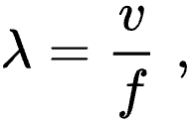
Wavelength of an electromagnetic wave
Wavelength of a sinusoidal waveform travelling at speed (v), frequency (f)
Electromagnetic waves that are travelling in free space, the speed is c or the speed of light. What is speed of light? 3×10⁸ m/s
Different color of light, different wavelength!
Notes:
First, we look at the computational elements, and these consist of a microcontroller or an FPGA. Today, we find that these computational elements consume at least one order of magnitude higher power consumption when compared to the commonly used sensors.
However, we also find that microcontrollers are increasingly becoming energy efficient. We investigate a typical microcontroller that has been used in sensor platforms over the past two decades. We find that energy efficiency has improved by almost two orders of magnitude. Some of the present-generation microcontrollers, such as Ambiq Apollo4 consume just 3 uA/MHz than 330 uA for MSP430 used on platforms such as TelOS B.
If the trend continues, we can expect the microcontrollers to catch up with the sensors and become energy-efficient. This significant improvement is that the digital components are increasing becoming efficient as they follow moore’s law.

Slide 11
What does the term radio mean?
Radio technology implies the task of transmission and reception of information using electromagnetic waves of frequency 3 Hz to 300 GHz. Electromagnetic waves at these frequencies are also called radio waves, and the frequency bands are called radio spectrum.
Notes:
First, we look at the computational elements, and these consist of a microcontroller or an FPGA. Today, we find that these computational elements consume at least one order of magnitude higher power consumption when compared to the commonly used sensors.
However, we also find that microcontrollers are increasingly becoming energy efficient. We investigate a typical microcontroller that has been used in sensor platforms over the past two decades. We find that energy efficiency has improved by almost two orders of magnitude. Some of the present-generation microcontrollers, such as Ambiq Apollo4 consume just 3 uA/MHz than 330 uA for MSP430 used on platforms such as TelOS B.
If the trend continues, we can expect the microcontrollers to catch up with the sensors and become energy-efficient. This significant improvement is that the digital components are increasing becoming efficient as they follow moore’s law.

Slide 12

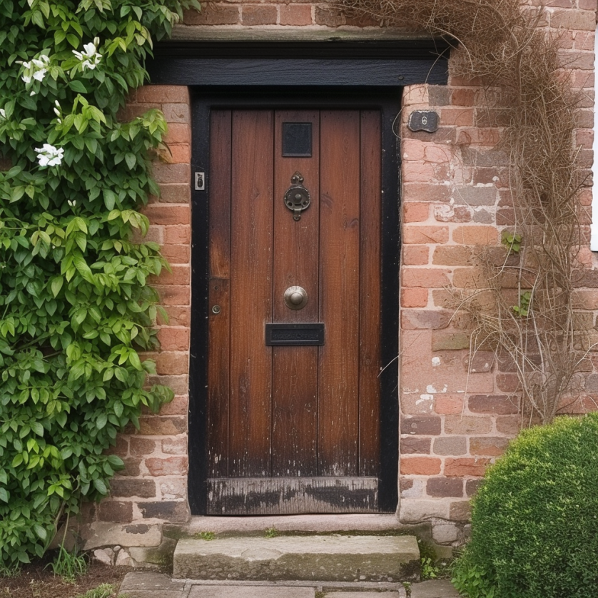
What does the term radio mean?
Radio technology implies the task of transmission and reception of information using electromagnetic waves of frequency 3 Hz to 300 GHz. Electromagnetic waves at these frequencies are also called radio waves, and the frequency bands are called radio spectrum.
What is wavelength of 100 MHz (FM Band) ? 3 Meters
Notes:
First, we look at the computational elements, and these consist of a microcontroller or an FPGA. Today, we find that these computational elements consume at least one order of magnitude higher power consumption when compared to the commonly used sensors.
However, we also find that microcontrollers are increasingly becoming energy efficient. We investigate a typical microcontroller that has been used in sensor platforms over the past two decades. We find that energy efficiency has improved by almost two orders of magnitude. Some of the present-generation microcontrollers, such as Ambiq Apollo4 consume just 3 uA/MHz than 330 uA for MSP430 used on platforms such as TelOS B.
If the trend continues, we can expect the microcontrollers to catch up with the sensors and become energy-efficient. This significant improvement is that the digital components are increasing becoming efficient as they follow moore’s law.

Slide 13


What does the term radio mean?
Radio technology implies the task of transmission and reception of information using electromagnetic waves of frequency 3 Hz to 300 GHz. Electromagnetic waves at these frequencies are also called radio waves, and the frequency bands are called radio spectrum.
What is wavelength of 100 GHz? 0.3 centimeter
Notes:
First, we look at the computational elements, and these consist of a microcontroller or an FPGA. Today, we find that these computational elements consume at least one order of magnitude higher power consumption when compared to the commonly used sensors.
However, we also find that microcontrollers are increasingly becoming energy efficient. We investigate a typical microcontroller that has been used in sensor platforms over the past two decades. We find that energy efficiency has improved by almost two orders of magnitude. Some of the present-generation microcontrollers, such as Ambiq Apollo4 consume just 3 uA/MHz than 330 uA for MSP430 used on platforms such as TelOS B.
If the trend continues, we can expect the microcontrollers to catch up with the sensors and become energy-efficient. This significant improvement is that the digital components are increasing becoming efficient as they follow moore’s law.

Slide 14
What are radio transceivers?
Radio transceivers are components that enables the transmission and reception of electromagnetic waves. A key component in wireless device
Antenna
Radio frequency signal
Transmitting
Device
Receiving Device
Notes:
First, we look at the computational elements, and these consist of a microcontroller or an FPGA. Today, we find that these computational elements consume at least one order of magnitude higher power consumption when compared to the commonly used sensors.
However, we also find that microcontrollers are increasingly becoming energy efficient. We investigate a typical microcontroller that has been used in sensor platforms over the past two decades. We find that energy efficiency has improved by almost two orders of magnitude. Some of the present-generation microcontrollers, such as Ambiq Apollo4 consume just 3 uA/MHz than 330 uA for MSP430 used on platforms such as TelOS B.
If the trend continues, we can expect the microcontrollers to catch up with the sensors and become energy-efficient. This significant improvement is that the digital components are increasing becoming efficient as they follow moore’s law.

Slide 15
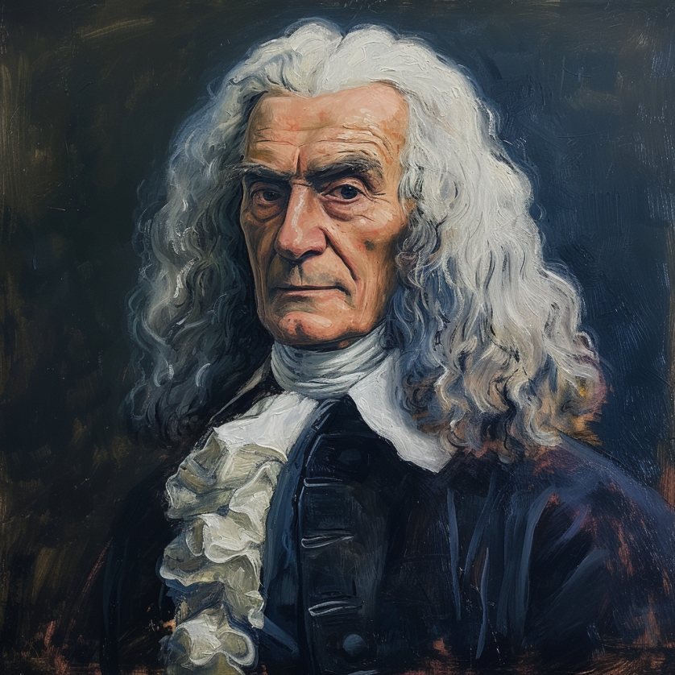
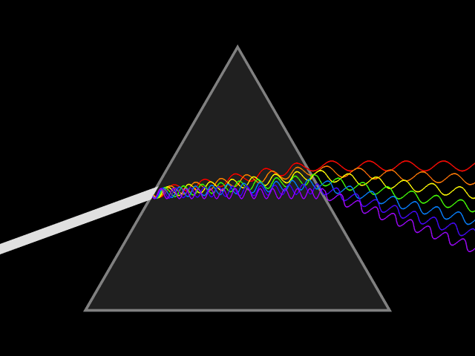
What do you mean by spectrum? Radio spectrum?
In the 17th century, Isaac Newton introduced the concept of the spectrum to the field of physical sciences, specifically in optics. He used this term to describe the array of colors visible when white light passed through a prism and was separated into its constituent hues. Later the term was expanded to include other waves, including radio waves.
Notes:
First, we look at the computational elements, and these consist of a microcontroller or an FPGA. Today, we find that these computational elements consume at least one order of magnitude higher power consumption when compared to the commonly used sensors.
However, we also find that microcontrollers are increasingly becoming energy efficient. We investigate a typical microcontroller that has been used in sensor platforms over the past two decades. We find that energy efficiency has improved by almost two orders of magnitude. Some of the present-generation microcontrollers, such as Ambiq Apollo4 consume just 3 uA/MHz than 330 uA for MSP430 used on platforms such as TelOS B.
If the trend continues, we can expect the microcontrollers to catch up with the sensors and become energy-efficient. This significant improvement is that the digital components are increasing becoming efficient as they follow moore’s law.

Slide 16
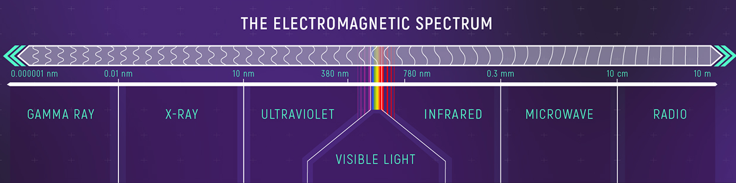
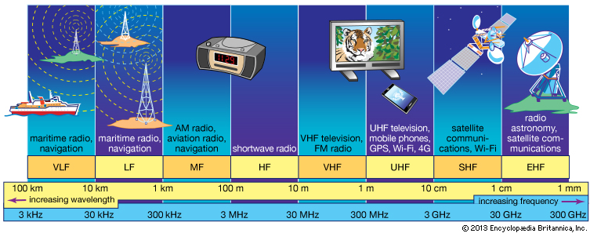
Radio waves most important part of EM spectrum
Notes:
First, we look at the computational elements, and these consist of a microcontroller or an FPGA. Today, we find that these computational elements consume at least one order of magnitude higher power consumption when compared to the commonly used sensors.
However, we also find that microcontrollers are increasingly becoming energy efficient. We investigate a typical microcontroller that has been used in sensor platforms over the past two decades. We find that energy efficiency has improved by almost two orders of magnitude. Some of the present-generation microcontrollers, such as Ambiq Apollo4 consume just 3 uA/MHz than 330 uA for MSP430 used on platforms such as TelOS B.
If the trend continues, we can expect the microcontrollers to catch up with the sensors and become energy-efficient. This significant improvement is that the digital components are increasing becoming efficient as they follow moore’s law.

Slide 17
How are radio waves characterized?
Radio waves can be characterized based on following parameters:
Strength/Power: energy contained in the radio wave
Frequency: rate of periodic variation between electric and magnetic field
Bandwidth: range of frequencies of radio waves present in the transmission
Polarization: orientation of electric field. May be circular, elliptical or linear
Modulation: variation of waves property to encode information
Notes:
First, we look at the computational elements, and these consist of a microcontroller or an FPGA. Today, we find that these computational elements consume at least one order of magnitude higher power consumption when compared to the commonly used sensors.
However, we also find that microcontrollers are increasingly becoming energy efficient. We investigate a typical microcontroller that has been used in sensor platforms over the past two decades. We find that energy efficiency has improved by almost two orders of magnitude. Some of the present-generation microcontrollers, such as Ambiq Apollo4 consume just 3 uA/MHz than 330 uA for MSP430 used on platforms such as TelOS B.
If the trend continues, we can expect the microcontrollers to catch up with the sensors and become energy-efficient. This significant improvement is that the digital components are increasing becoming efficient as they follow moore’s law.

Slide 18
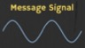
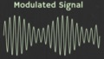
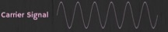
How are radio waves modified to carry information
Encoding information “baseband" in an analog “carrier” signal
Baseband signal often much lower in frequency than the carrier
Frequency of the carrier signal dictates the part of the radio spectrum
Why? baseband signals or information change is at much lower rate
Speech: upto 20 KHz, temperature changes – few Hz
Enables a better usage of the radio spectrum
Enables communication among several devices sharing the spectrum
Modulation
Notes:
First, we look at the computational elements, and these consist of a microcontroller or an FPGA. Today, we find that these computational elements consume at least one order of magnitude higher power consumption when compared to the commonly used sensors.
However, we also find that microcontrollers are increasingly becoming energy efficient. We investigate a typical microcontroller that has been used in sensor platforms over the past two decades. We find that energy efficiency has improved by almost two orders of magnitude. Some of the present-generation microcontrollers, such as Ambiq Apollo4 consume just 3 uA/MHz than 330 uA for MSP430 used on platforms such as TelOS B.
If the trend continues, we can expect the microcontrollers to catch up with the sensors and become energy-efficient. This significant improvement is that the digital components are increasing becoming efficient as they follow moore’s law.

Slide 19
What are different modulation techniques?
Vary frequency, amplitude, phase of carrier signal according message signal
We can also vary them together to support complex modulation schemes
Analog and Digital counterparts of these modulation schemes exist
Modulation
Notes:
First, we look at the computational elements, and these consist of a microcontroller or an FPGA. Today, we find that these computational elements consume at least one order of magnitude higher power consumption when compared to the commonly used sensors.
However, we also find that microcontrollers are increasingly becoming energy efficient. We investigate a typical microcontroller that has been used in sensor platforms over the past two decades. We find that energy efficiency has improved by almost two orders of magnitude. Some of the present-generation microcontrollers, such as Ambiq Apollo4 consume just 3 uA/MHz than 330 uA for MSP430 used on platforms such as TelOS B.
If the trend continues, we can expect the microcontrollers to catch up with the sensors and become energy-efficient. This significant improvement is that the digital components are increasing becoming efficient as they follow moore’s law.

Slide 20
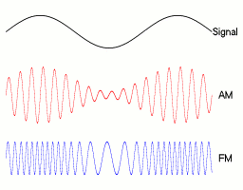
Amplitude modulation: vary amplitude of carrier signal
Change amplitude of a carrier signal according to the message signal
Simplest and the earliest introduced modulation technique
Remains widely used for radio broadcast, also computer communication
Disadvantage: signal prone to interference, less bandwidth efficient
Notes:
First, we look at the computational elements, and these consist of a microcontroller or an FPGA. Today, we find that these computational elements consume at least one order of magnitude higher power consumption when compared to the commonly used sensors.
However, we also find that microcontrollers are increasingly becoming energy efficient. We investigate a typical microcontroller that has been used in sensor platforms over the past two decades. We find that energy efficiency has improved by almost two orders of magnitude. Some of the present-generation microcontrollers, such as Ambiq Apollo4 consume just 3 uA/MHz than 330 uA for MSP430 used on platforms such as TelOS B.
If the trend continues, we can expect the microcontrollers to catch up with the sensors and become energy-efficient. This significant improvement is that the digital components are increasing becoming efficient as they follow moore’s law.

Slide 21
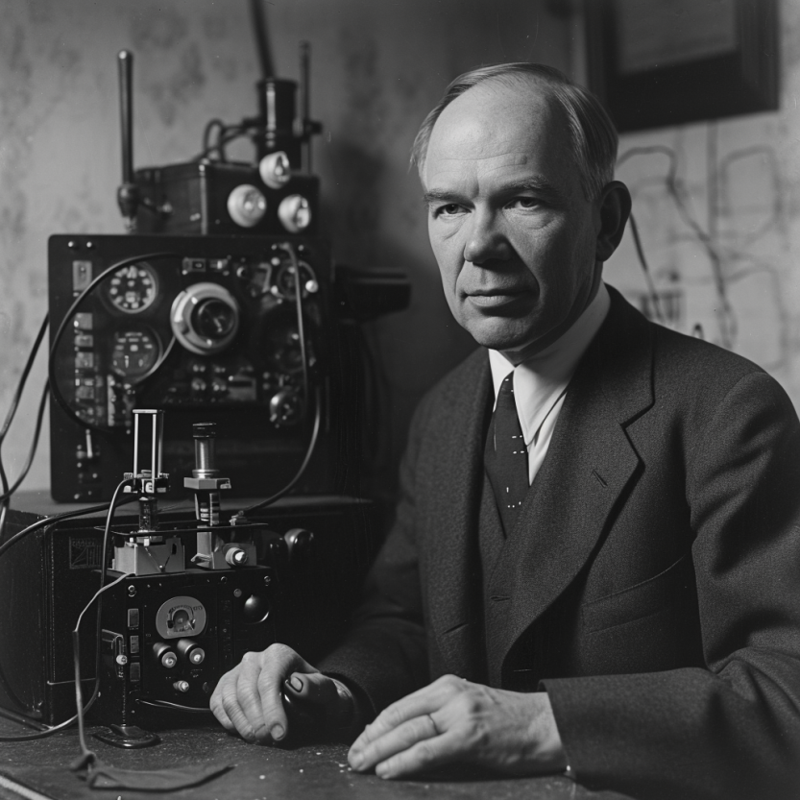
Frequency modulation: vary frequency of carrier signal
Change frequency of a carrier signal according to the message signal
Advantages (over AM): Resilient to interference, spectrum efficiency
Remains widely used for radio broadcast, also computer communication
First demonstrated by Armstrong in 1935!
Notes:
First, we look at the computational elements, and these consist of a microcontroller or an FPGA. Today, we find that these computational elements consume at least one order of magnitude higher power consumption when compared to the commonly used sensors.
However, we also find that microcontrollers are increasingly becoming energy efficient. We investigate a typical microcontroller that has been used in sensor platforms over the past two decades. We find that energy efficiency has improved by almost two orders of magnitude. Some of the present-generation microcontrollers, such as Ambiq Apollo4 consume just 3 uA/MHz than 330 uA for MSP430 used on platforms such as TelOS B.
If the trend continues, we can expect the microcontrollers to catch up with the sensors and become energy-efficient. This significant improvement is that the digital components are increasing becoming efficient as they follow moore’s law.

Slide 22
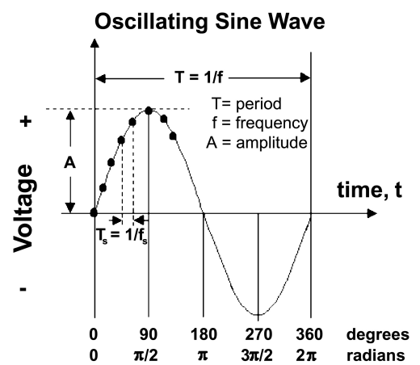
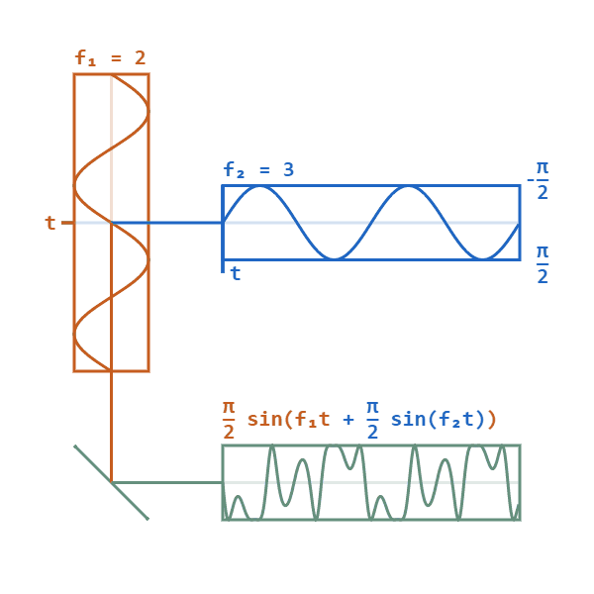
Phase modulation: vary phase of carrier signal
Change phase of a carrier signal according to the message signal
It is an integral part of modern communication standards: WiFi, Television
Advantages (over FM): Better SNR, spectral efficiency
Notes:
First, we look at the computational elements, and these consist of a microcontroller or an FPGA. Today, we find that these computational elements consume at least one order of magnitude higher power consumption when compared to the commonly used sensors.
However, we also find that microcontrollers are increasingly becoming energy efficient. We investigate a typical microcontroller that has been used in sensor platforms over the past two decades. We find that energy efficiency has improved by almost two orders of magnitude. Some of the present-generation microcontrollers, such as Ambiq Apollo4 consume just 3 uA/MHz than 330 uA for MSP430 used on platforms such as TelOS B.
If the trend continues, we can expect the microcontrollers to catch up with the sensors and become energy-efficient. This significant improvement is that the digital components are increasing becoming efficient as they follow moore’s law.

Slide 23
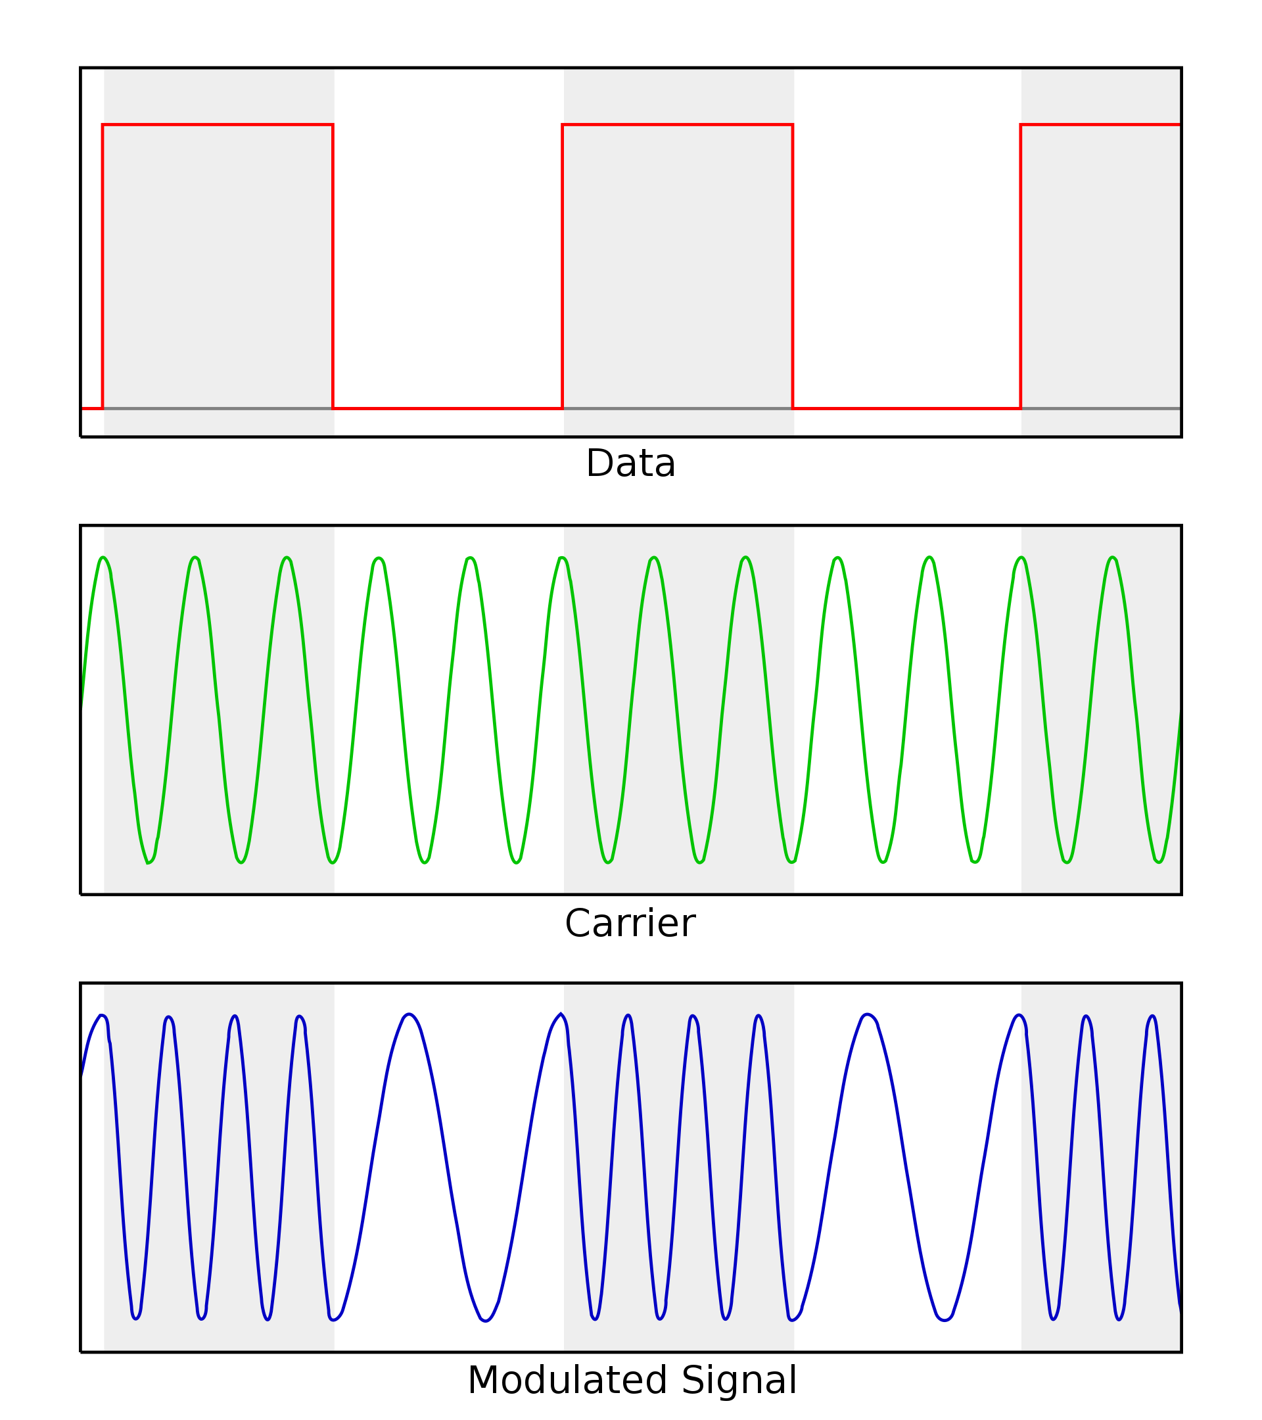
Digital equivalent of the AM, FM and PM modulation
Digital variant of these schemes vary analog signal according to digital bits
ASK: amplitude shift keying
FSK: frequency shift keying
PSK: phase shift keying
Digital variants relevant when we talk about computer communication
Notes:
First, we look at the computational elements, and these consist of a microcontroller or an FPGA. Today, we find that these computational elements consume at least one order of magnitude higher power consumption when compared to the commonly used sensors.
However, we also find that microcontrollers are increasingly becoming energy efficient. We investigate a typical microcontroller that has been used in sensor platforms over the past two decades. We find that energy efficiency has improved by almost two orders of magnitude. Some of the present-generation microcontrollers, such as Ambiq Apollo4 consume just 3 uA/MHz than 330 uA for MSP430 used on platforms such as TelOS B.
If the trend continues, we can expect the microcontrollers to catch up with the sensors and become energy-efficient. This significant improvement is that the digital components are increasing becoming efficient as they follow moore’s law.

Slide 24
How radio waves propagate to the receiver
Antenna
Radio frequency signal
Transmitting
Device
Receiving Device

Slide 25
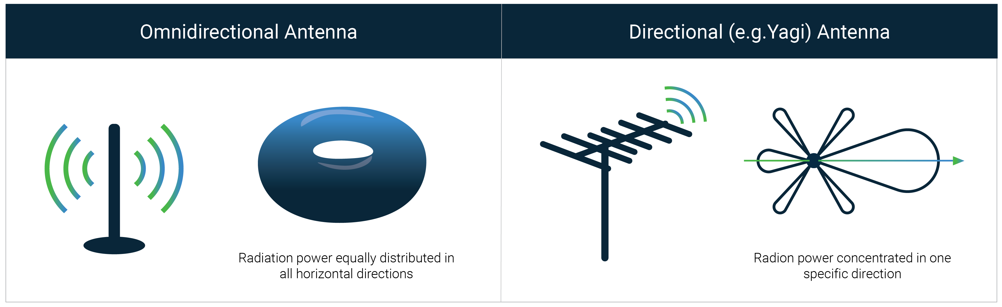
How radio waves radiate out from transceiver
Antenna: An electrical conductor or system of conductors
Transmission: radio frequency electrical energy converted into electromagnetic energy
Reception: the reverse occurs, electromagnetic energy converted into electrical energy
Antennas can be categorized intro directional or omnidirectional
Based on the radiation pattern of the antenna

Slide 26
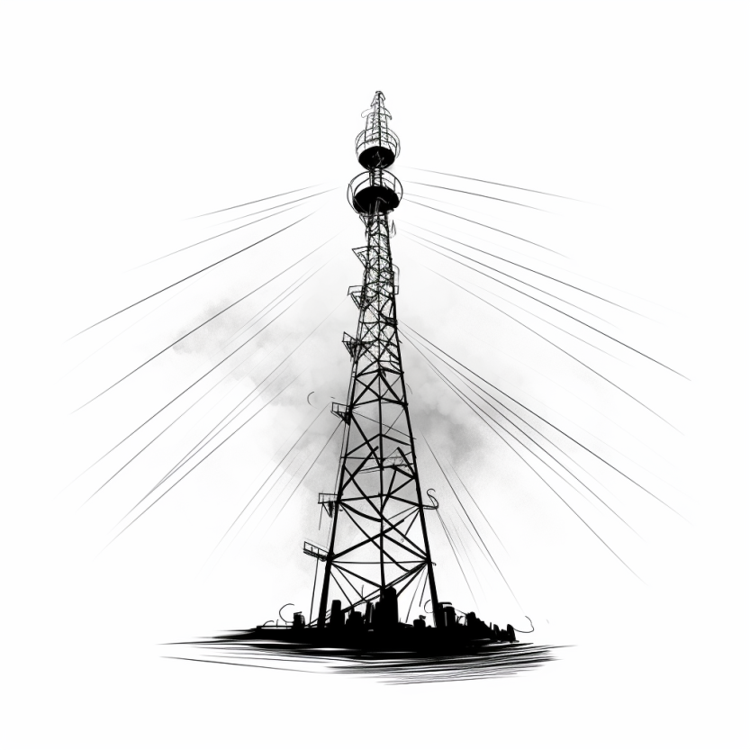
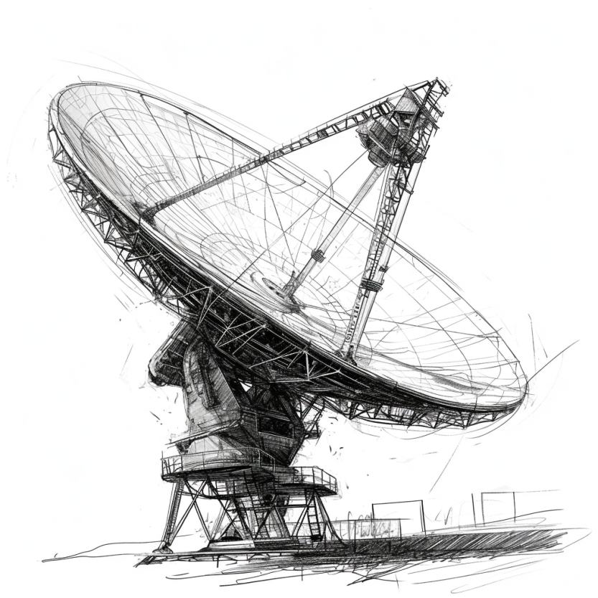
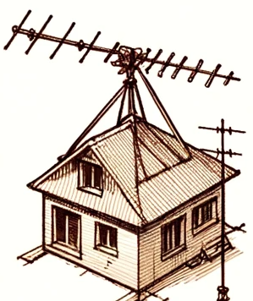

Common antenna types used for communication
Monopole: A straight wire mounted on conductive surface (ground plane)
Array: A set of connected antenna elements working together
Loop: A loop or wire or a conductor that acts like an antenna
Aperture: Transmits/receives electromagnetic wave through a hole
….. (and even more exists) …..

Slide 27
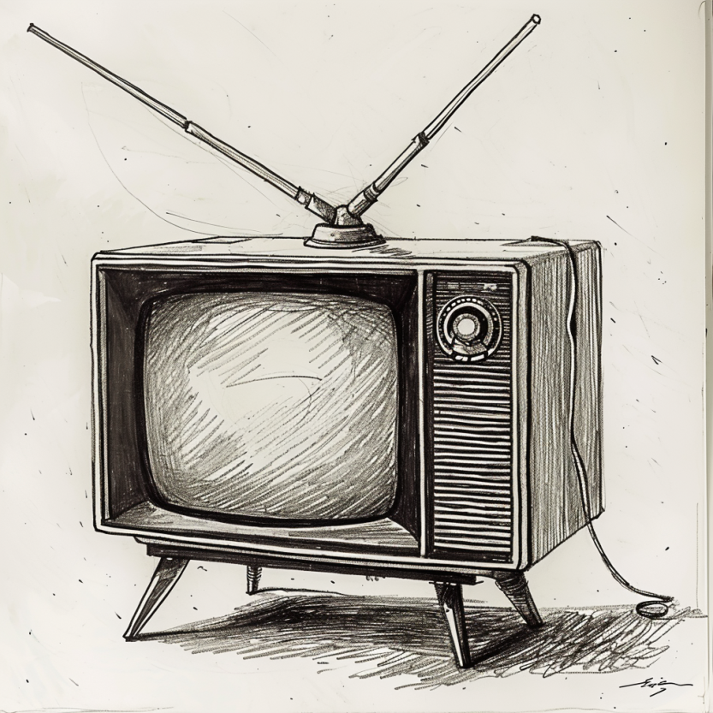
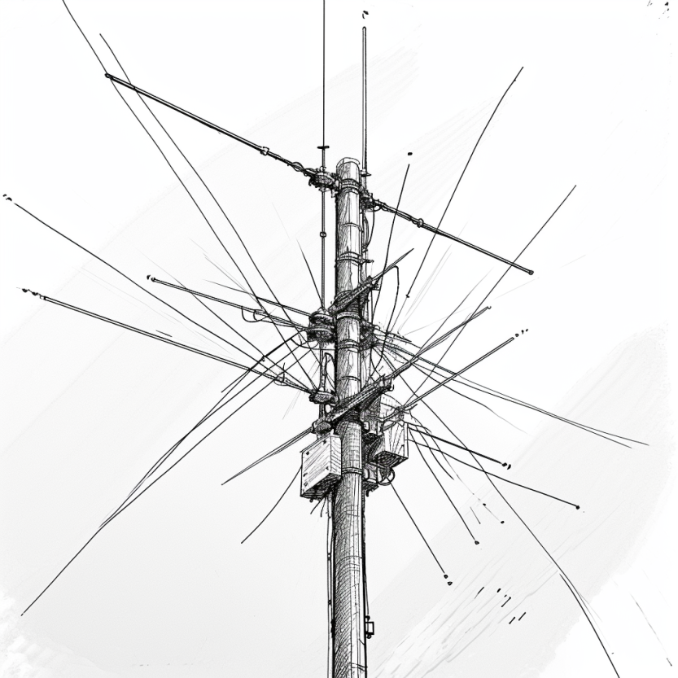
Dipole antenna types used for communication
Dipole antenna: A simple antenna consisting of wires pointed in opposite directions arranged either horizontally or vertically, with end of each wire connected to the radio and the other end is hanging in the free space
Half-wave dipole: A more efficient variation of dipole antenna is the half-wave dipole antenna, which radiates energy efficiently when the wavelength of radio signal is twice the electrical length of the antenna

Slide 28
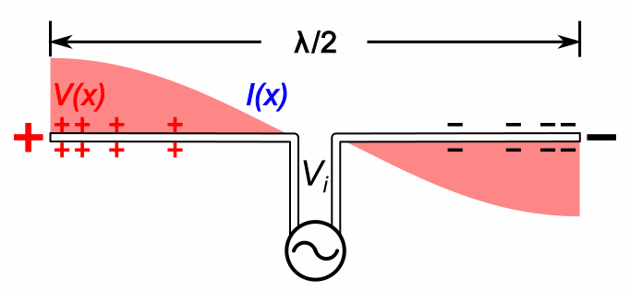
Relationship between antenna size and frequency
Antenna size is inversely proportional to the frequency of radio wave
Higher the frequency, smaller the antenna size
Lower frequency, larger is the antenna size
For example:
Dipole: Length of the conductor is half of the wave length of radio wave
Half-wave dipole: Length of conductor is quarter wavelength of radio wave

Slide 29
Understanding the performance of an antenna
Gain of antenna: It is a dimensionless quantity that measures the ability of an antenna to direct or receive radio waves in a particular direction compared to a reference. It is usually measured in the unit of decibel (dB)
Often measured in reference to hypothetical isotropic antenna (dBi)
Can be measured in reference to a halfwave dipole antenna (dBd)
Antennas are reciprocal in nature. Transmit and receive equally well
Tradeoffs: Higher the gain, more directional is the transmission and reception, and the narrower would be the beam

Slide 30
Understanding the performance of an antenna
Power output, in a particular direction, compared to that produced in any direction by a perfect omni-directional antenna (isotropic antenna)‏
Effective area: related to physical size and shape of antenna
Relationship between antenna gain and effective area
G = antenna gain
A_{e} = effective area
f = carrier frequency
c = speed of light 3 X 10⁸ m/s
Lambda = carrier wavelength

Slide 31
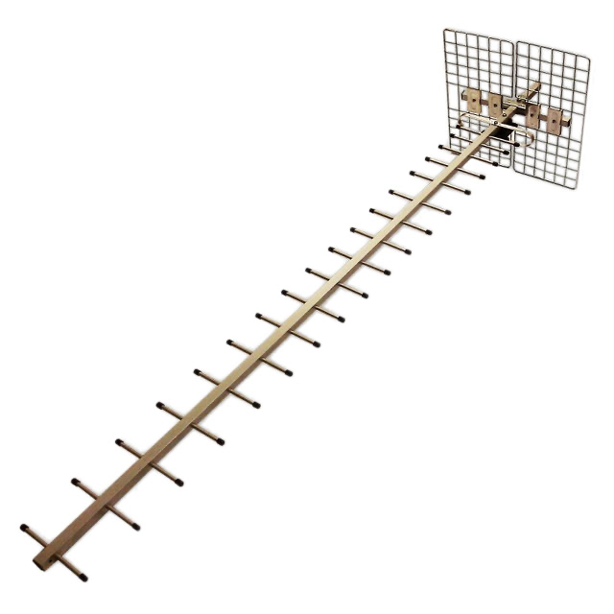
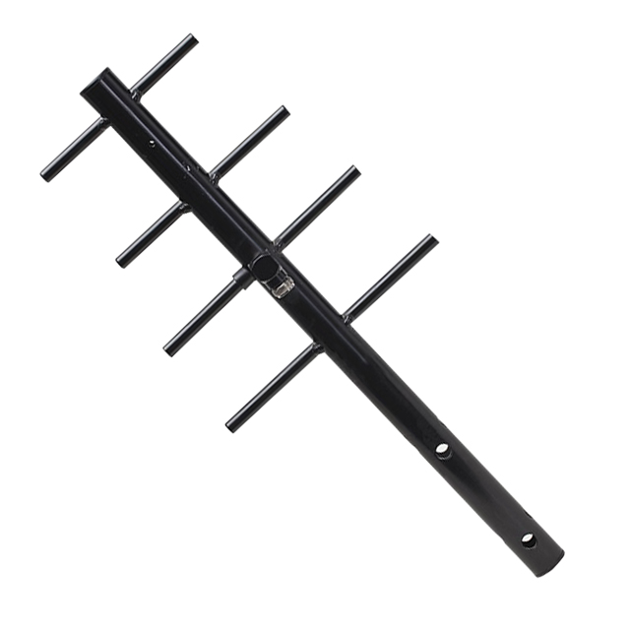
Revisiting antennas and their gain
Yagi-uda antenna. It has a very high gain. The gain and directionality increases with the number of antenna elements.
Antenna Gain: 23 dBi
Antenna Gain: 8 dBi

Slide 32
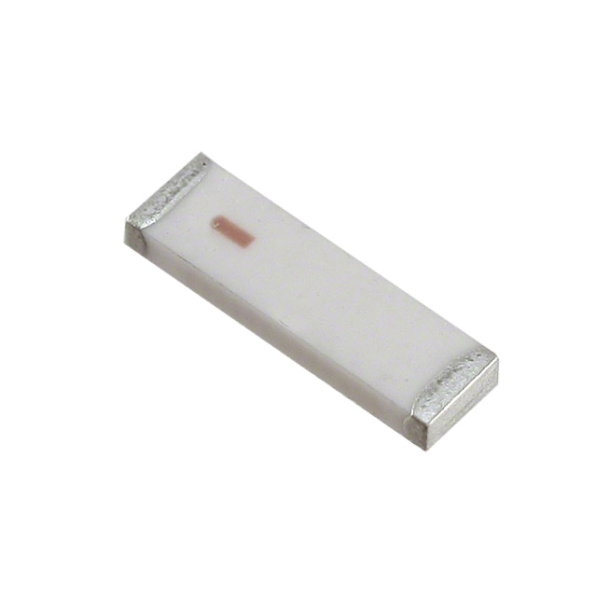
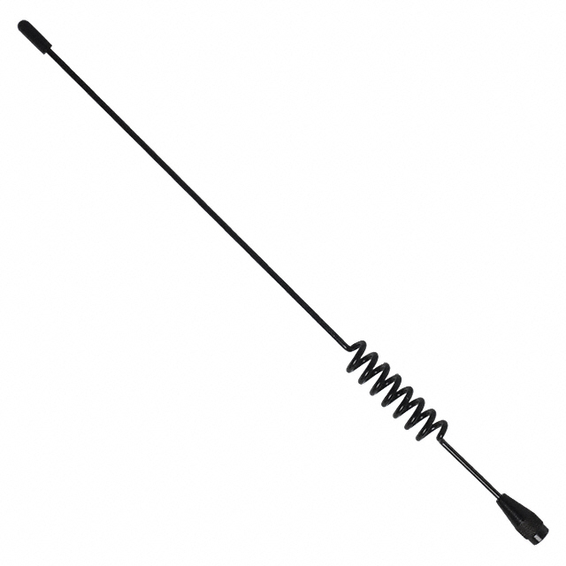
Revisiting antennas and their gain
Chip antenna makes sacrifice due to smaller form factor and hence the least gain. Whip antenna has less directionality than Yagi-uda antenna.
Antenna Gain: -1 dBi
Antenna Gain: 3.8 dBi

Slide 33
Radio Waves Propagation
Notes:
++ Over the past few years, I have designed several backscatter and beyond backscatter systems that precisely overcome these critical challenges that have limited the widespread deployment of backscatter on IoT devices.
++ The research vision that I have pursued and would like to pursue as a faculty member is to enable a massive deployment of IoT devices by bridging the energy asymmetry between sensing, computation and communication blocks by designing novel platforms and communication mechanisms. I am going to describe some of my research contributions next.

Slide 34

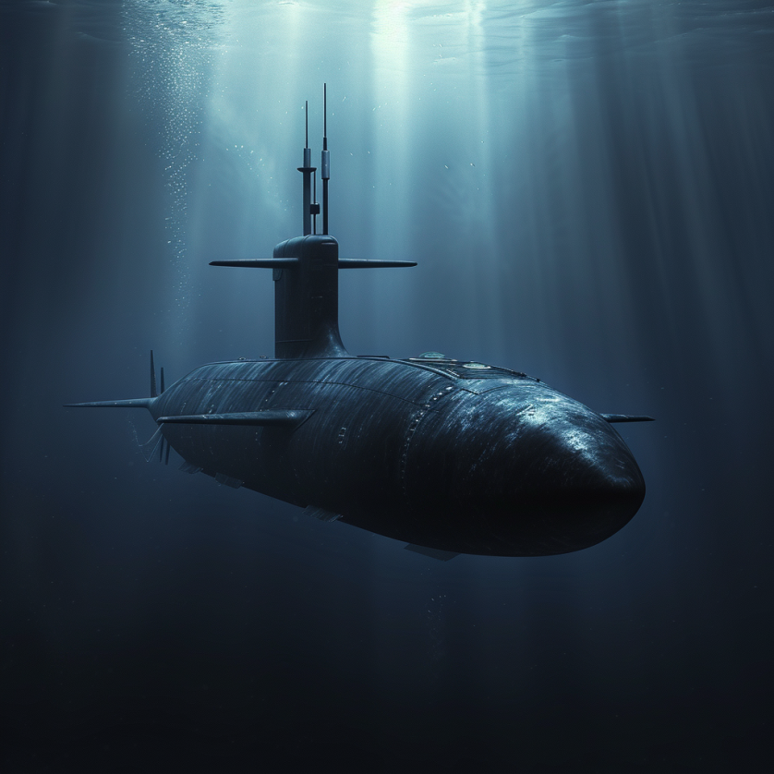
How do radio waves propagate from TX to RX?
Medium and environment has an important role to play in propagation
Radio waves do not propagate well underwater. Submarines uses sound
Environment impacts the radio wave propagation significantly
Reduced communication range
Interference from other devices
Issues with reliability
…… and many more

Slide 35
Radio propagation is complex in real-world, especially when obstacles are present

Slide 36
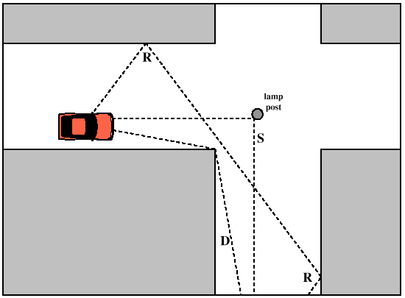
Radio propagation is complex in real-world, especially when obstacles are present
Reflection
e.g. earth surface, buildings
Diffraction
Radio wave bends around the obstacle
Scattering
Obstacles smaller than wavelength of wave (e.g. foliage)
Signal is scattered into several weaker signals

Slide 37
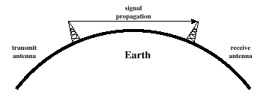
Radio waves propagation in line-of-sight
Transmitting and receiving antennas must be within line of sight
Satellite communication – signal above 30 MHz not reflected by ionosphere
Ground communication – antennas in effective line of site due to refraction

Slide 38
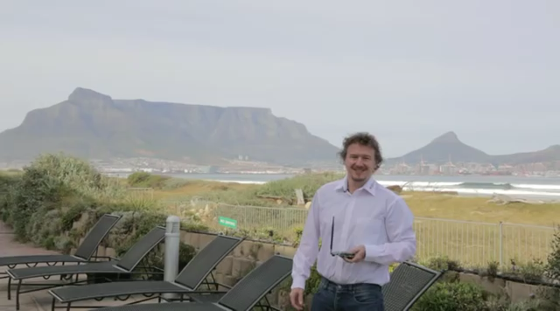
Long range wireless transmissions using IoT devices

Slide 39

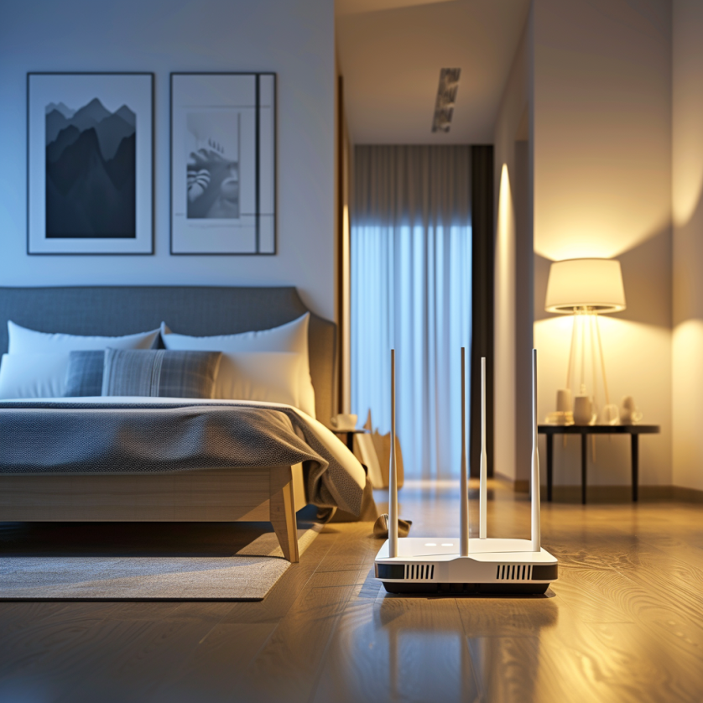
Non-line of sight propagation of radio waves
Transmitter and receiver are not kept in line of sight
Radio waves encounter obstacles, may go through walls, buildings
Much more applicable to read world environment and deployments
Significantly impacts the communication range and reliability

Slide 40
Terminology and Equations
Notes:
++ Over the past few years, I have designed several backscatter and beyond backscatter systems that precisely overcome these critical challenges that have limited the widespread deployment of backscatter on IoT devices.
++ The research vision that I have pursued and would like to pursue as a faculty member is to enable a massive deployment of IoT devices by bridging the energy asymmetry between sensing, computation and communication blocks by designing novel platforms and communication mechanisms. I am going to describe some of my research contributions next.

Slide 41
Estimating received signal strength and range: Friis propagation model
f_{c} is the center frequency in Hz
c is speed of light
d is the distance between transmitter and receiver
Alpha is the path loss component
G is antenna gain

Slide 42
Path Loss Exponent
Environment
Path Loss Exponential (α)
Free Space
2
Urban area cellualr radio
2.7 to 3.5
Shadowed urban cellular radio
3 to 5
In building LOS
1.6 to 1.8
Obstructed in building
4 to 6
Obstructed in factory
2 to 3
Rapport, Table 4.2, pp139

Slide 43
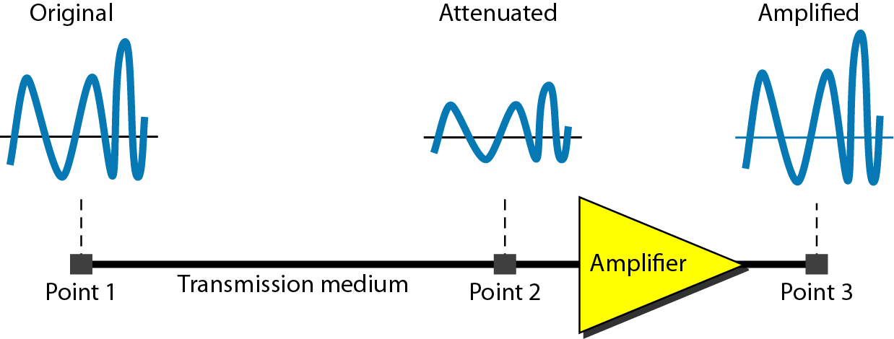
Attenuation and Gain: Decibel (dB) unit
Attenuation: Means loss of energy
When signal traverses through a medium, it loses energy.
Gain: Means increase in energy
Often devices such as amplifiers are employed to improve the signal strength
Commonly, we use decibel to calculate gain or loss/attenuation of signal
dB = 10log₁₀P₂/P₁
P₁ - input signal, P₂ - output signal

Slide 44
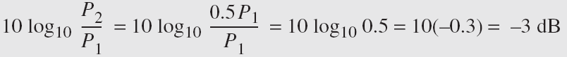
Operations in decibel (dB) examples
Suppose a signal travels through a transmission medium and its power decreases to one-half of its original value, meaning that P2 is equal to (1/2)P1. In this scenario, the attenuation, or loss of power, can be determined using the following formula:
Thus, loss of 3 dB, is equivalent to losing half of the signal power

Slide 45
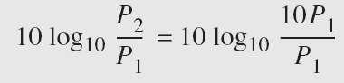
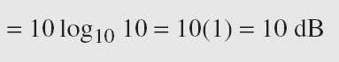
Operations in decibel (dB) examples
A signal passes through an amplifier, resulting in a tenfold increase in power, expressed as P2 = 10P1. The amplification, also known as the power gain, can be calculated as:
One reason engineers use decibels to measure changes in signal strength is that decibel values can be easily added or subtracted
L1 = 3b, L2 = 7 db, Combined loss: 10 dB

Slide 46
Basics of wireless communication and networking
Link Budget: One of the metrics that help you understand the gains and losses in a communication system. Applicable to radio waves, communication happening through cables, and other systems
High link budget ensures that the wireless signal is received with a sufficient signal to noise (SNR) ratio for recovering of the sent information
Receiver Power (dBm) = Transmitted Power (dBm) + Gains (dB) – Losses (dB)

Slide 47
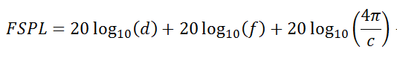
Basics of wireless communication and networking
Free space path loss (FSPL or FSL): The loss of power encountered by signal as it transmits from the transmitter to the receiver
d is the distance between the transmitter and receiver antennas (in meters),
f is the frequency of the signal (in Hertz),
c is the speed of light in a vacuum

Slide 48
Basics of wireless communication and networking
Signal to Noise (SNR) ratio: It is defined as the ratio of the desired or target signal when compared to the background noise
SNR = P(signal) / P(noise)
Often, SNR as a ratio is expressed in the units of decibel (dB)
SNR = 1, what would be the value in decibel?
We would like to have the SNR to be as high as possible. For communication systems, it means stronger desired signal, resulting in better link quality and reliability

Slide 49
Basics of wireless communication and networking
How do you estimate the capacity of the channel?
And what do you mean by the capacity of the channel?
Shannon capacity of the channel: The bandwidth available (B) , The quality of the channel (the level of noise, SNR)
C = B * log₂(1+SNR)
Intuitively, capacity increases with available bandwidth (linear) and increases with SNR (log)

Slide 50
Various tradeoffs in range, frequency, datarate, power
Power is (usually) a constraint
Increase in power can result in higher range/data rate
Lower lifespan of the device
Increase data rate (C)
Increase throughput by using a larger bandwidth (B)
Transmits at higher frequencies (f)
Range decreases and vice versa
Improve design to increase gain (G)
e.g. OFDM, MIMO etc.
C = B * log₂(1+SNR)
SNR – signal-to-noise ratio

Slide 51
Whitespace and Tradeoffs
Notes:
++ Over the past few years, I have designed several backscatter and beyond backscatter systems that precisely overcome these critical challenges that have limited the widespread deployment of backscatter on IoT devices.
++ The research vision that I have pursued and would like to pursue as a faculty member is to enable a massive deployment of IoT devices by bridging the energy asymmetry between sensing, computation and communication blocks by designing novel platforms and communication mechanisms. I am going to describe some of my research contributions next.

Slide 52
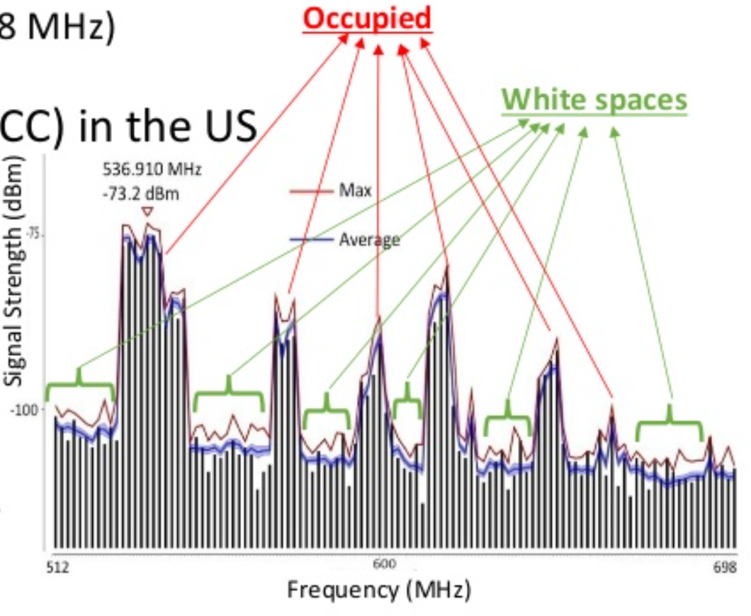
TV whitespaces
Unused TV channels between 54 MHz and 698 MHz
VHF (54-216 MHz)
UHF (470-698 MHz)
6 MHz channel width
Allocated but unused
FCC allows unlicensed use
IF you do not interfere with primary users

Slide 53
Sensing channel use
Variation in use
Spatial: Cannot assume same channel will be free everywhere
Temporal: Cannot assume channel will be free at all times
Cognitive radio approach
Dynamically identify unused portions of spectrum
Database approach
Let someone else do the scanning. Consult database based on location and time

Slide 54
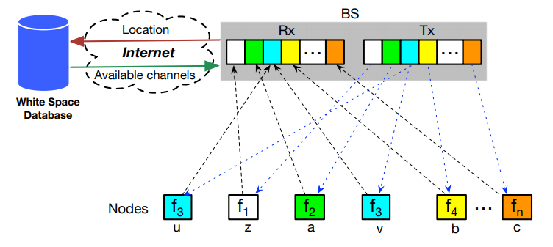
Sensor Networks Over tv Whitespaces (SNOW)
A design for sensor networks over whitespaces
Base Station manages channel for deployment
Frequency division for devices. Each uplinks on separate subcarrier
Downlink is one OFDM transmission. Each device hears its frequency

Slide 55
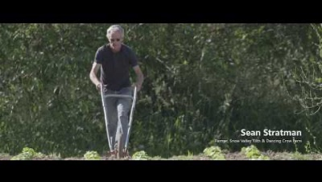
Farmbeats (TV Whitespace) (Courtesy: Microsoft)

Slide 56
How do we characterize wireless networks/standards
Four parameters help to characterize wireless networks:
Communication Range
Data Rate
Power
Frequency Band

Slide 57
Wireless standards classified on basis of throughput
1 Gbps
802.11ac
4G
802.11n
High Rate UWB
100 Mbps
10 Mbps
1 Mbps
Bluetooth
BLE/802.15.4
100 kbps
LoRA
UWB (802.15.4-2011)
NFC
10 kbps
1GHz
2GHz
3GHz
4GHz
5GHz
6GHz

Slide 58
Wireless standards classified on basis of range
10km
LoRA
4G
1km
100m
802.11n
BLE/802.15.4
UWB (802.15.4-2011)
Bluetooth
802.11ac
10m
1m
NFC
High Rate UWB
1GHz
2GHz
3GHz
4GHz
5GHz
6GHz

Slide 59
Wireless standards classified on the basis of power
10W
4G
1W
802.11n
802.11ac
UWB
100mW
LoRA
Bluetooth
BLE/802.15.4
NFC (Reader)
10mW
1mW
1GHz
2GHz
3GHz
4GHz
5GHz
6GHz

Slide 60
Low-Power Widearea
Notes:
++ Over the past few years, I have designed several backscatter and beyond backscatter systems that precisely overcome these critical challenges that have limited the widespread deployment of backscatter on IoT devices.
++ The research vision that I have pursued and would like to pursue as a faculty member is to enable a massive deployment of IoT devices by bridging the energy asymmetry between sensing, computation and communication blocks by designing novel platforms and communication mechanisms. I am going to describe some of my research contributions next.

Slide 61
LPWANs overview (common qualities)
Unlicensed 915 MHz band (902-928 MHz)
Higher power transmissions: ~20 dBm (100 mW)
Low data rate 100 kbps or less
Range on the order of multiple kilometers
Simple Aloha access control

Slide 62
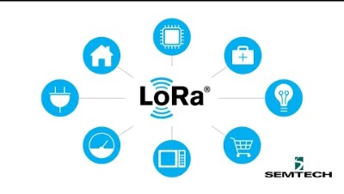
Overview of LoRa standard (Courtesy: Semtech)

Slide 63
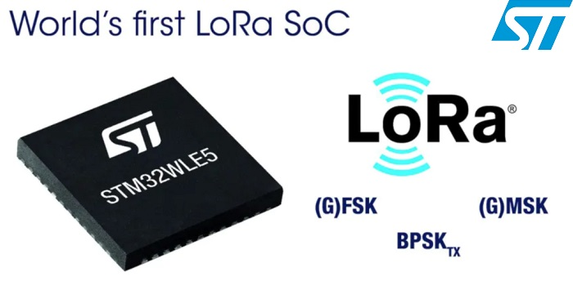
LoRaWAN
Open communication standard built with proprietary LoRa PHY
Operates in the unlicensed band
Low data rate (1-20 kbps) and long range (~5 km)
Most popular LPWAN protocol
Academic research and industry involvement

Slide 64

LoRa employs a different modulation scheme
Chirp Spread Spectrum (CSS): Modulation technique where frequency is varied linearly from lowest to highest within a channel

Slide 65

Chirp Spread Spectrum
Data is modulated in the starting and ending points of chirp
Frequency increases linearly, modulo bounds of the channel

Slide 66

Spreading factor of CSS modulation
Spreading Factor is essentially the rate-of-change of frequency
Slope of the line
Lower values of spreading factor (steeper slope) are faster data rate
Important: different spreading factors are (mostly) orthogonal!
Two can overlap in time, space, and channel without a collision

Slide 67

Overview of CSS (brief video)

Slide 68

Channel allocation for LoRa
Sixty-four, 125 kHz uplink channels
Frequency Hopping over the 64 uplink channels
Plus eight, 500 kHz overlapping uplink channels (not well used in practice)
Eight, 500 kHz downlink channels

Slide 69
LoRa data rates
Data Rate Index | Spreading Factor | Bit Rate
125 kHz Uplink Rates
0 | SF10, 125 kHz | 980 bps
1 | SF9, 125 kHz | 1760 bps
2 | SF8, 125 kHz | 3125 bps
3 | SF7, 125 kHz | 5470 bps
500 kHz Uplink Rates
4 | SF8, 500 kHz | 12500 bps
500 kHz Downlink Rates
8 | SF12, 500 kHz | 980 bps
9 | SF11, 500 kHz | 1760 bps
10 | SF10, 500 kHz | 3900 bps
11 | SF9, 500 kHz | 7000 bps
12 | SF8, 500 kHz | 12500 bps
13 | SF7, 500 kHz | 21900 bps
Data rate depend on channel in use, spreading factor
64-channel uplink
1-5 kbps data rate

Slide 70
LoRa transmissions are received on gateway
No synchronization with the end devices
Instead listen to entire bandwidth simultaneously (12 MHz total)
Recognize preambles and allocate a hardware to decode packet
Normal gateways: 8 decoders/ Good gateways: 64 decoders

Slide 71
LoRa link budget and transmission range
Typical TX power 20 dBm
Up to 30 dBm for 64-channel hopping
Up to 26 dBm for 8-channel hopping
Receive sensitivity -119 dBm/-146 dBm (highest SF)
Compare to -100 dBm for 802.15.4 and -95 dBm for BLE
Resulting range is kilometers in urban environments

Slide 72


You can build your own LoRa network
Easy-to-use, off-the-shelf hardware available (tens of USD)
Could be useful for projects that you may do in this course

Slide 73


LoRaWAN network providers
Network provides with a deployment of gateways
The Things Network (predominantly in Europe)
Helium
Any can buy and install their own gateway, which serves everyone
Microtransactions to pay for communication

Slide 74

Helium Scale [Jan 2022]

Slide 75

Things Network

Slide 76

Helium Network

Slide 77

Sigfox
Very low-rate (600 bps), very long-range (10+ km) communication
Star-topology networks, with always-listening gateways
Any number of low-power end devices
Uplink-focused communication
Applications: very low-rate metering

Slide 78

Sigfox PHY
Unlicensed-band communication
Europe 868 MHz. US 902-928 MHz (915 MHz band)
Ultra-narrowband 600 Hz (100 Hz Europe) channel bandwidth
Detection only needs to occur at very specific frequency
Helps improve signal-to-noise ratio

Slide 79
Sigfox unbalanced uplink and downlink
Uplink
600 Hz bandwidth, 600 bps, DBPSK
Downlink
1.5 kHz bandwidth, 600 bps, GFSK
Particularly optimized for Europe
Uplink on 1% duty cycle channel, up to 14 dBm
Downlink on 10% duty cycle channel, up to 27 dBm
Works fine in US too
Gets more power (24 dBm up is typical, up to 32 dBm down) and more range

Slide 80
Sigfox link budget
Why transmit at 100-600 bps?
For greatly increased link budget
Link budget: 150-160 dBm
Assuming Tx at ~20 dBm
Means Rx Sensitivity of -130 dBm (10 dBm better than LoRaWAN)
Resulting range: 10-15 km in urban environments
Except that buildings lead to dead spots in range

Slide 81

Sigfox coverage (Winter 2021)

Slide 82
Bluetooth, ZigBee and Wi-Fi
Notes:
++ Over the past few years, I have designed several backscatter and beyond backscatter systems that precisely overcome these critical challenges that have limited the widespread deployment of backscatter on IoT devices.
++ The research vision that I have pursued and would like to pursue as a faculty member is to enable a massive deployment of IoT devices by bridging the energy asymmetry between sensing, computation and communication blocks by designing novel platforms and communication mechanisms. I am going to describe some of my research contributions next.

Slide 83
Basics of Bluetooth Low Energy (BLE)
Direct device-to-device communication
Usually: Computer to Thing
Smartphone to device, Laptop to device, etc.
Focus on making the “Thing” really low energy
Push energy-intensive requirements onto “Computer”

Slide 84
Two different communication modes in BLE
Advertising
Discovery
Advertisements – broadcast messages indicating device details
Ephemeral, uni-directional communication from Advertiser to Scanner(s)
ALOHA access control
Connections
Interaction
Bi-directional communication between Peripheral and Central
Maintained for some duration
TDMA access control

Slide 85
BLE network topology
Peripheral
Connection
Central & Scanner
Scanner
Connection
Peripheral
Advertisement
Advertisement
Advertisement
Advertisement
Advertiser
Advertiser
Advertiser

Slide 86
Bluetooth devices multiple roles at the same time
Topology picture is a simplification of roles
A single device can have multiple roles simultaneously
Scanning and Advertising simultaneously
Peripheral and Scanner and Advertiser simultaneously
Peripheral and Scanner and Central and Advertiser simultaneously
Also possible:
One Peripheral can be connected to multiple Central

Slide 87

BLE frequency
2.4 GHz carrier, Forty 2-MHz channels, 1 Mbps data rate
37, 38, 39 for advertising
0-36 for connection (FHSS)

Slide 88

BLE modulation
Gaussian Frequency-Shift Keying (GFSK)
Improvement on base Frequency-shift Keying
Smoother transitions between bits -> reduces nearby interference

Slide 89
ZigBee goals
Enable automatic communication between devices
Low complexity
Low power
Focus on home automation and industrial control/monitoring
From our perspective
802.15.4 PHY and MAC
Designed for higher-power devices than Thread or BLE
Although still relatively low power

Slide 90
ZigBee history
Intertwined with the creation of 802.15.4
Both are founded around the same time
ZigBee Alliance involved in the original 802.15.4 specification
Recently renamed: Connectivity Standards Alliance (CSA)
Original plan: 802.11/WiFi <-> 802.15.4/ZigBee

Slide 91



Use of 802.15.4
Basic answer: everything
Reuse all of PHY (including non-2.4 GHz channels)
Reuse all of MAC (including beacon-enabled network and GTS)
Same CSMA/CA mechanism

Slide 92
ZigBee devices (same roles as 802.15.4 defines)
ZigBee Coordinator (ZC)
Starts the network and decides on key parameters
Is also a Router
ZigBee Router (ZR)
Higher-power, more-capable devices
Radios always on (except during inactive superframe)
Connect to one or more children
Connect to one or more routers
ZigBee End Device (ZED)
Lower-power, less-capable devices
Always a child of one router

Slide 93

Older ZigBee - tree networks
Original preferred topology
Uses beacon-enabled network
Synchronization via beacon superframes
Can reduce power requirements for routers
Some things get simpler
Address assignment is simple
If you restrict network size
Routing is straightforward
But likely more hops for router-to-router communication

Slide 94

Modern ZigBee – mesh networks
Presently preferred topology
Uses non-beacon-enabled network
All routers are always-on devices
Allows arbitrary communication between routers
Some tradeoffs
Higher power routers
Routing more complicated (potentially better algorithms though)
Addressing more complicated
Assign random addresses to each node
Include a method for address conflict resolution

Slide 95

Example ZigBee network

Slide 96

A problem: the siloed internet of things
Problem: companies are more interested in selling you the whole stack
Which then makes it harder for devices to be interoperable
This is not Thread or IP-specific, but a problem all IoT devices are facing

Slide 97

Matter Wireless Standard

Slide 98
IEEE standard for LPWANs
n.b.
802 = “area networking”
.3 = “LANs”
.11 = “Wireless LANs”
.15 = “PANs”
802.11ah (HaLow) standard in 2016
First real hardware in 2020
Still not in real-world use yet
Focus on the indoor-to-outdoor scenario
Medium range (maximum 1 km)
915 MHz communication
NOT interoperable with other 802.11 access points and devices
Theoretically up to 356 Mbps
Practically, most devices are expected to implement 150 kbps to 8 Mbps

Slide 99

802.11ah allows multiple bandwidth allocations

Slide 100

WiFi Hallow Range Test (Courtesy: Newracom)

Slide 101

WiFi capability in microcontrollers
ESP32
Microcontroller plus WiFi radio in single chip
(Same idea as nRF52840)
Capabilities
802.11b/g/n 2.4 GHz only
20 MHz or 40 MHz channels
Single antenna only (no MIMO)
MCS0-7
7 Mbps – 150 Mbps
Tx power up to 20.5 dBm

Slide 102
Low power WiFi
Question: should a microcontroller stay connected or reconnect?
Light sleep: stay connected always, only listening to beacons
Deep sleep: reconnect to network each time data is ready
Answer for ESP32 depends on security and data interval
Resecuring during connection takes lots of energy
Crossover point is about 60 seconds
Insecure transmissions have a crossover of 5-15 seconds
https://blog.voneicken.com/2018/lp-wifi-esp-comparison/#conclusions

Slide 103
802.11ax (2021)
Standard approved on February 9th 2021
First devices started supporting it in 2019 (WiFi 6)
6 GHz band (WiFi 6E)
1.2 GHz of bandwidth (5.925-7.125 GHz)
2020: US FCC made band available for unlicensed use!!!
EU is expected to follow in March 2021
OFDMA
MAC scheduling variant of OFDM
Schedule devices based on time and subcarrier allocations

Slide 104

6 GHz band is an enormous amount of bandwidth

Slide 105

Orthogonal Frequency Division Multiple Access
OFDM: split channel into subcarriers and transmit on those
OFDMA: allocate subcarriers to a device for an amount of time
Turns OFDM into an access control mechanism
Complicated question: which device gets which subcarriers at which time?

Slide 106
CS5272: From next week
Next Week:
Topic Preview from instructor of LLM (10-15 minutes)
Student seminars (25-30 mins)
Two weeks from now:
TinyML: Presentation of end-to-end design by Dr. Manoj Gulati
One student Seminar on TinyML (topic)
Notes:
Backscatter communication actually help us overcome this limitation

Slide 107
Embedded Software Design
Ambuj Varshney
ambujv@nus.edu.sg
Notes:
++ Thank you for inviting me to give this talk
++ In this talk, I will present a pathway that can enable us to make wireless embedded systems ubiquitous. I will describe my previous research efforts that tackle the critical challenges that limit the growth of wireless embedded systems. These are related to the growing energy asymmetry that exists between sensing, computation and communication blocks on these platforms.
++ Finally, I will conclude my talk by covering the research agenda that I would like to work on as a faculty member.

